Slide 1
Secure text transfer using Diffie-Hellman key Exchange Based on Cloud
Submitted in the partial fulfillment for the award of the degree of
BACHELOR OF ENGINEERING
IN
COMPUTER SCIENCE WITH A SPECIALIZATION IN
INFORMATION SECURITY
Submitted by:
ABHAY TOMER
20BCS3566
Under the Supervision of:
MR NAMIT CHAWLA
Department of AIT-CSE
DISCOVER . LEARN . EMPOWER

Slide 2

Outline
Introduction to Project
Problem Formulation
Objectives of the work
Methodology used
Results and Outputs
Conclusion
Future Scope
References

Slide 3
Introduction to Project
Diffie-Hellman encryption is a method of securely exchanging cryptographic keys over an insecure channel. It was invented by Whitfield Diffie and Martin Hellman in 1976 and is widely used in modern cryptography.
The basic idea behind Diffie-Hellman encryption is that two parties, Alice and Bob, can agree on a shared secret key without actually exchanging the key itself. Instead, they exchange some public information and use it to independently compute the same secret key.

Slide 4

In Diffie-Hellman encryption, Alice and Bob each choose a large prime number and a primitive root modulo that prime. They then publicly exchange their prime numbers and primitive roots. Using this information, Alice and Bob can each generate their own secret key, which they keep private. They then use the other party's public information and their own secret key to compute a shared secret key, which can be used to encrypt and decrypt messages between them.

Slide 5
Problem Formulation
The Diffie-Hellman key exchange algorithm is widely used for establishing shared secret keys, but it has limitations and potential vulnerabilities.
These include susceptibility to man-in-the-middle attacks, weak key exchange parameters, lack of authentication, implementation flaws, and potential threats from quantum computing.

Slide 6

To mitigate risks, it's important to use strong parameters, implement authentication, keep software and systems updated, and consider alternative cryptographic algorithms for future security.

Slide 7

Objectives of the Work
Creating a web app that can transfer text over the cloud with a secure channel using cryptographic techniques involves several additional steps to ensure the confidentiality and integrity of the data.

Slide 8
Methodology used
1. Plan and Design
2. Set up React
3. Set up Firebase
4. Connect React and Firebase
5. Implement Real-time Messaging
6. Test and Deploy
7. Maintain and Update

Slide 9
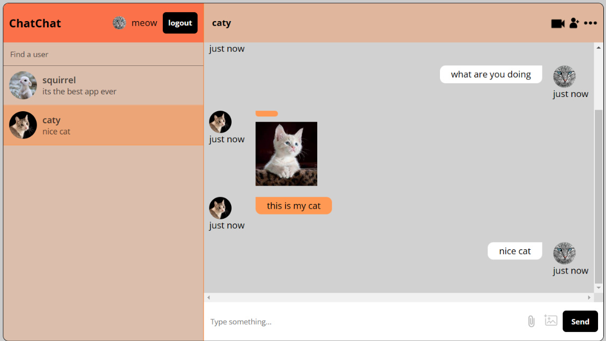
Results and Outputs
The web chat application developed is a real-time messaging platform that enables users to communicate with each other over the internet.

Slide 10
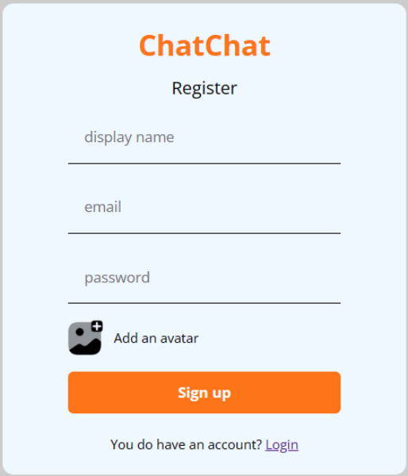

Results and Outputs
The front-end is built using the popular React library, which allows for efficient and modular development of user interfaces.

Slide 11
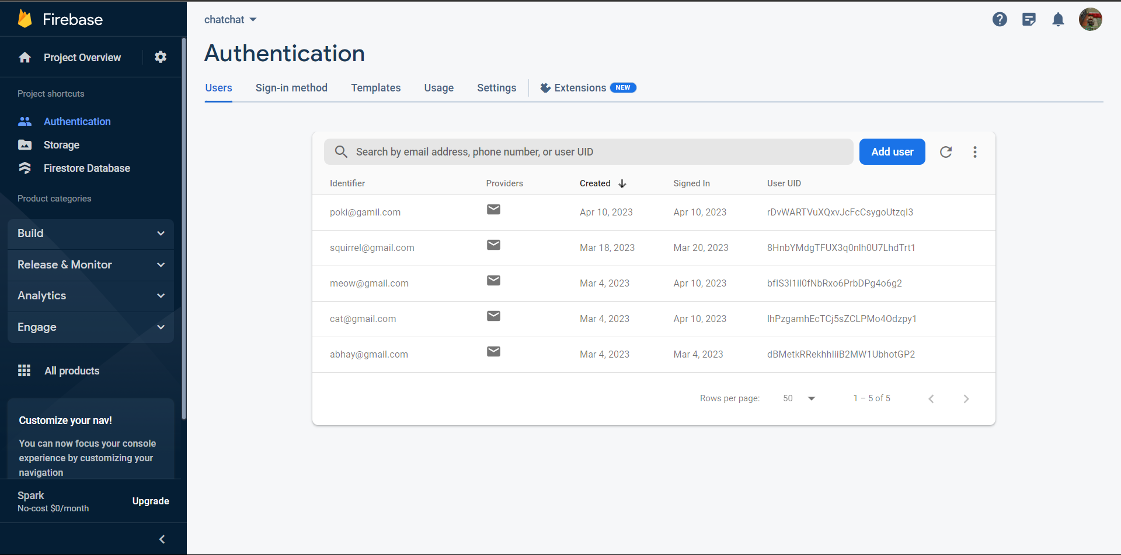

Results and Outputs
The back-end is powered by Firebase, a cloud-based platform that provides a range of services, including real-time database, hosting, and authentication.

Slide 12
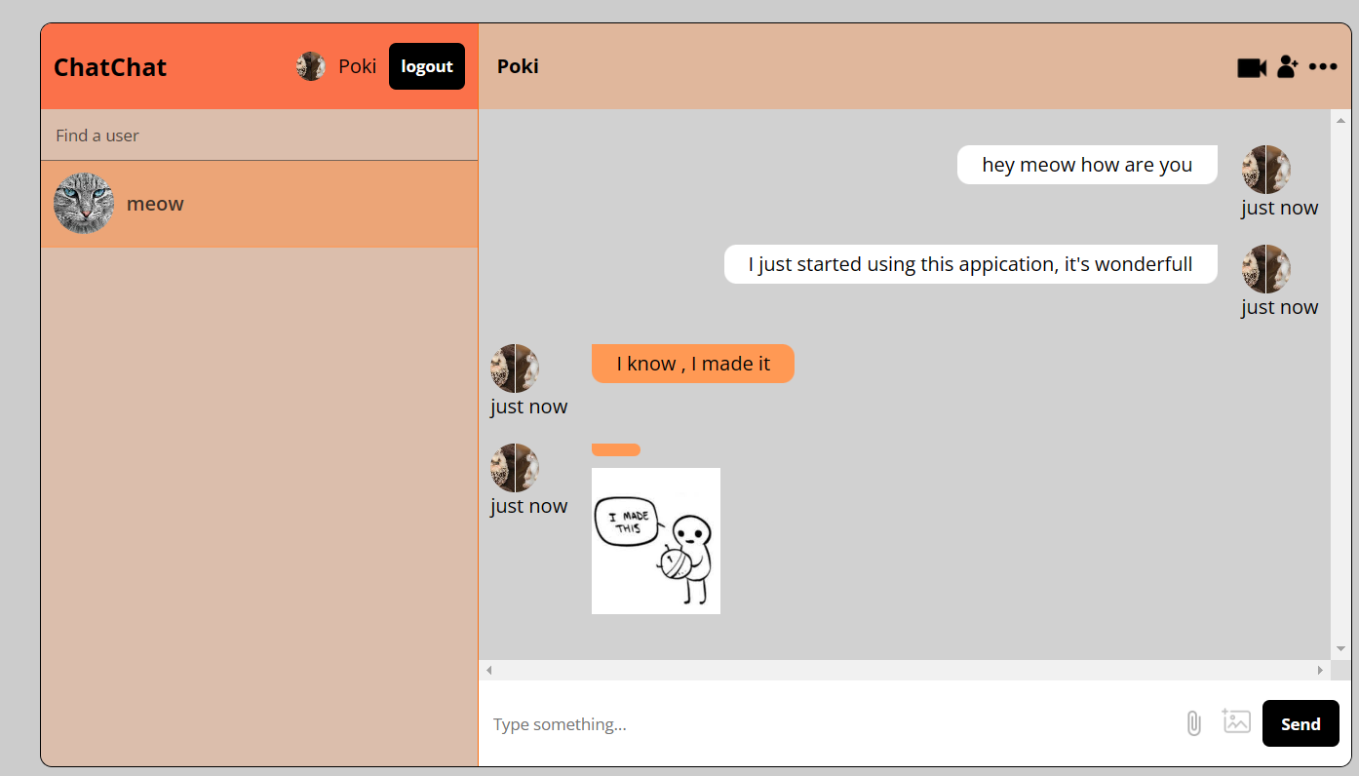
Results and Outputs
The web chat application is simple, intuitive, and easy to use. With React and Firebase, we've created a powerful combination that enables us to build real-time messaging applications quickly and easily.

Slide 13
Results and Outputs
Users can sign up for an account and log in to the web chat application, which will authenticate them and enable them to access the chat interface. Once logged in, users can create new chat rooms or join existing ones, and start messaging with other users in real-time. The chat application will store all messages in the Firebase real-time database, which will enable all users in a given chat room to see the same messages at the same time.

Slide 14
Conclusion
Finally, a real-time chat application built using React and Firebase can offer users a smooth and enjoyable chatting experience. Firebase provides a dependable and scalable backend solution for real-time data synchronisation and storage, while React offers a robust framework for creating user interfaces.
By providing a quick, dependable, and fun messaging experience, a real-time chat application built using React and Firebase has the potential to revolutionise how people communicate online.

Slide 15
Future Scope
More functionality such as chat groups.
Video confrencing
stories and status

Slide 16
References
[1] Prevention of the Man-in-the-Middle Attack on Diffie–Hellman Key Exchange Algorithm, DOI:10.1007/978-981-15-7834-2_58,Samrat Mitra, Samanwita Das, Malay Kule
[2] Weak keys of the Diffe Hellman key exchange I January 2005 Amit Kalele, Virendra R. Sule
[3] A Diffie-Hellman Key Exchange Protocol with Entities Authentication, Om Pal , Bashir Alam, ISSN:2319-7242 Volume 6 Issue 4 April 2017
[4] The Simplest Protocol for Oblivious Transfer Tung Chou, Claudio Orlandi, Proceedings of the 4th International Conference on Progress in Cryptology -- LATINCRYPT 2015 - Volume 9230August 2015
[5] Delay and cost performance analysis of the diffie-hellman key exchange protocol in opportunistic mobile networks March 2018 DOI:10.1088/1742-6596/978/1/012016, Bambang Soelistijanto, University of Surrey, Vinsen Muliadi
[6] Security Issues in the Diffie-Hellman Key Agreement Protocol January 2002 IEEE Transactions on Information Theory 22, Jean-francois Raymond, Anton Stiglic
[7] ECDH-ECC: A Combination of Elliptic Curve Cryptography and Diffie Hellman Based Cryptography technique for Big Data Security October 2018 DOI:10.13140/RG.2.2.27179.18722, Dr.Subhashini Radhakrishnan, Adilakshmi Vadavalli
[8] DHIES: An encryption scheme based on the Diffie-Hellman Problem January 1998, Michel Abdalla, Mihir Bellare, Phillip Rogaway
[9] Improved Diffie-Hellman Algorithm for Network Security Enhancement, November 2018, DOI:10.13140/RG.2.2.22694.78404 Vishal Garg, Rishu
[10] HMQV: A High-Performance Secure Diffie-Hellman Protocol,Advances in Cryptology – CRYPTO 2005 Conference paper, Hugo Krawczyk

